Slide 1
EEE 598: Generative AI: Theory and Practice
Group #11
Venkata Koppolu (Lead)
Atmadip Dey

Slide 2
Project Topic & Paper Reference
Topic: Memorization in Diffusion Models
Main Paper: Gu, X., Du, C., Pang, T., Li, C., Lin, M., & Wang, Y. (2025). On Memorization in Diffusion Models. Transactions on Machine Learning Research
Related Paper: Carlini, N., Hayes, J., Nasr, M., Jagielski, M., Sehwag, V., Tramèr, F., Balle, B., Ippolito, D., & Wallace, E. (2023). Extracting training data from diffusion models. arXiv
Sol: Jennewein, D. M. et al. (2023). The Sol Supercomputer at Arizona State University. In Practice and Experience in Advanced Research Computing (PEARC ’23), pp. 296–301. ACM

Slide 3
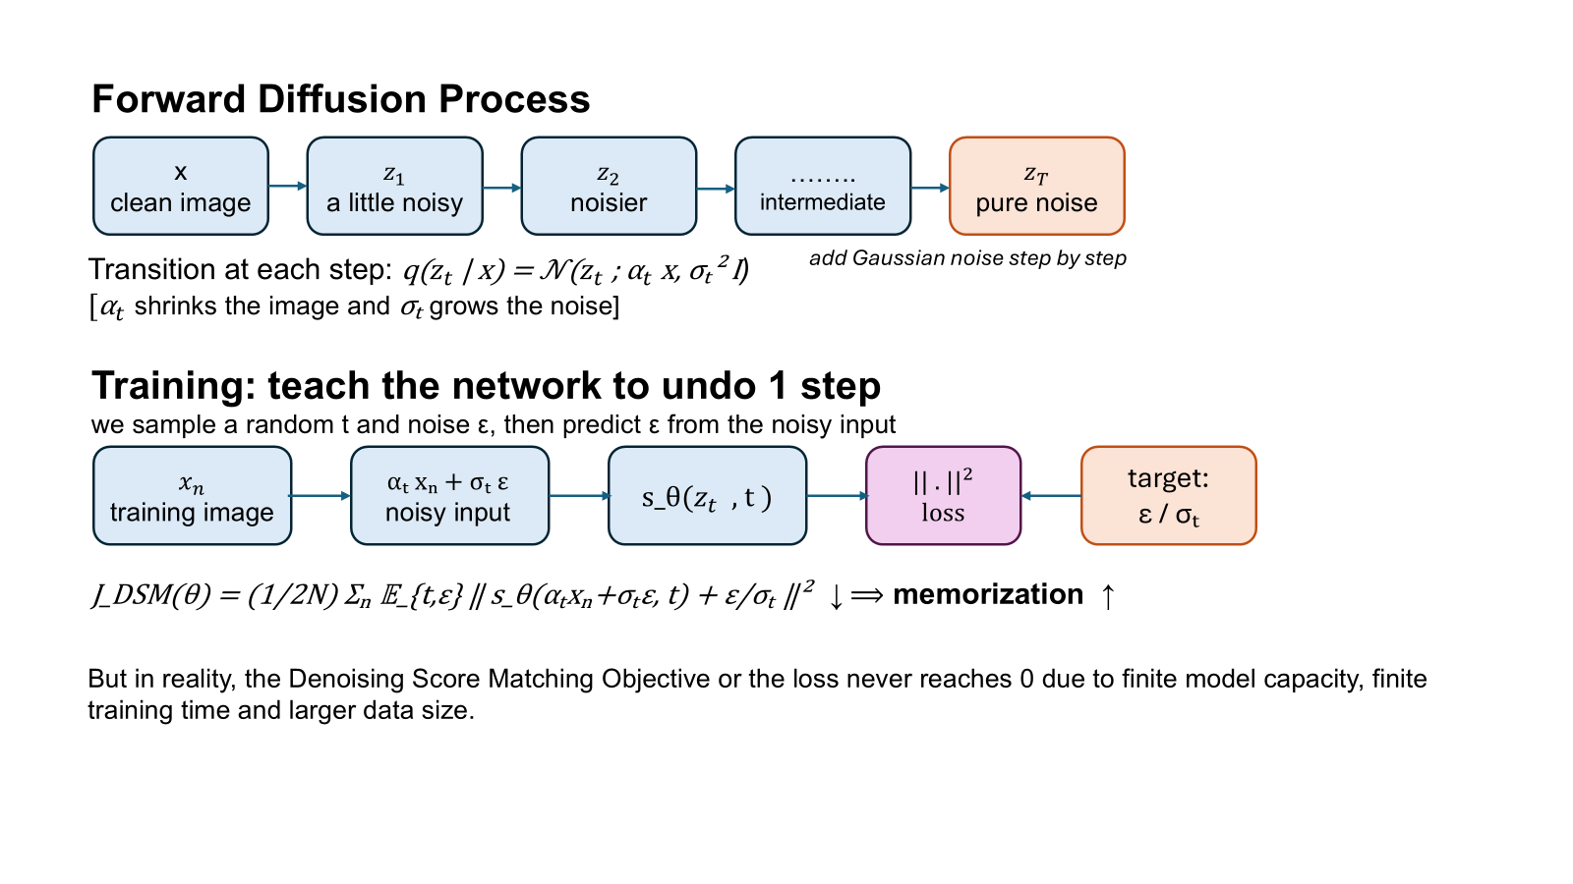
Motivation
Source: Gu et al. (2025)

Slide 4
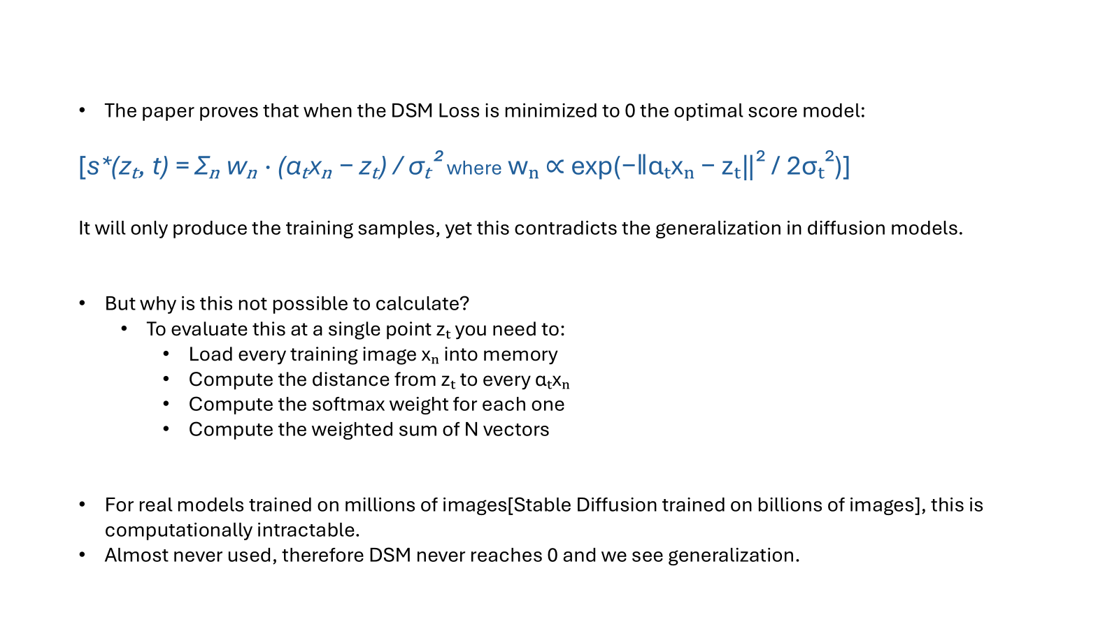
Motivation (Cont.)
Source: Gu et al. (2025)
Source: Gu et al. (2025)

Slide 5
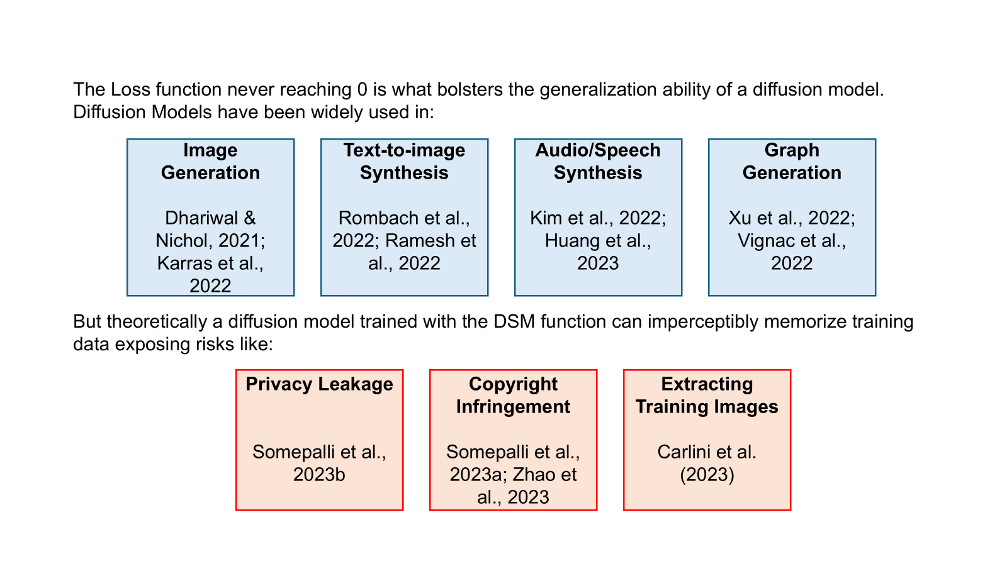
Positives and Negatives of the DSM Loss

Slide 6
Goal of the Paper
Goal:
Provide an a comprehensive empirical study on memorization behavior in widely adopted diffusion models, including EDM (Karras et al., 2022) and Stable Diffusion (Rombach et al., 2022) by tuning certain parameters across
the model, dataset and training process.
Core Idea: Generalization is not what diffusion models are designed to do. It is what happens when they fail to fully memorize.

Slide 7
Key Ideas from the Paper
How Memorization is Defined:
Compare generated image to nearest training samples. Compute distance ratio: ratio=d1/d2 where d1 is distance to nearest neighbor and d2 is distance to second nearest neighbor
Memorization Criterion: If ratio < threshold (≈ 1/3) → memorized sample, otherwise → generalized sample
Note: The paper adopts the memorization criterion from Yoon et al. (2023).

Slide 8
Defintions of Memorization Metrics
External Review - Carlini et al. 2023:
The fraction of generated images that can be matched to a specific training image by an automated detector or human judge.
KNN Distance - Carlini et al. 2023:
Mean L2 distance from each generated image to its single nearest training neighbor (d1 alone, no ratio).
SSCD Embedding Similarity - Somepalli et al. 2023:
Computes similarity in a semantic embedding space using SSCD, a self-supervised copy detection network, rather than raw pixel values.

Slide 9
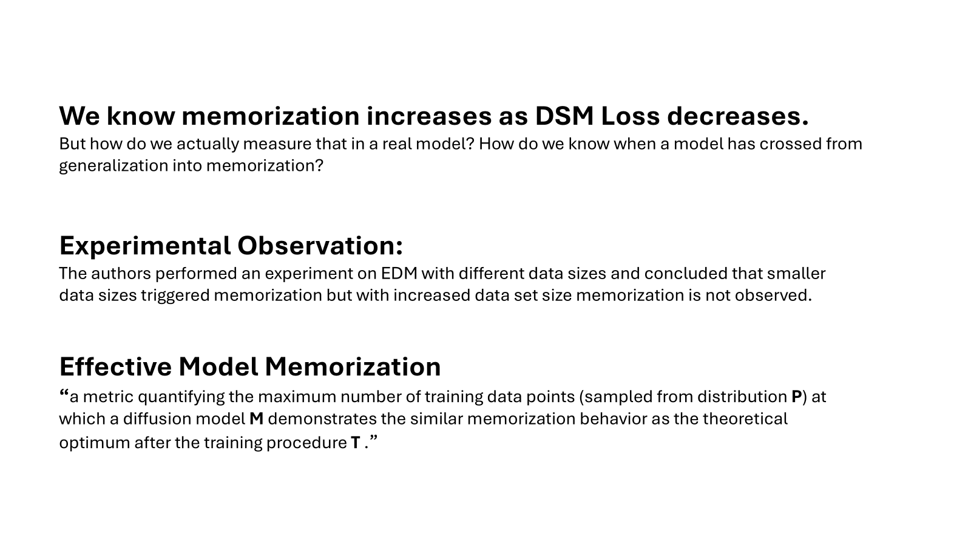
Key Ideas from the Paper (Cont.)
Source: Gu et al. (2025)

Slide 10
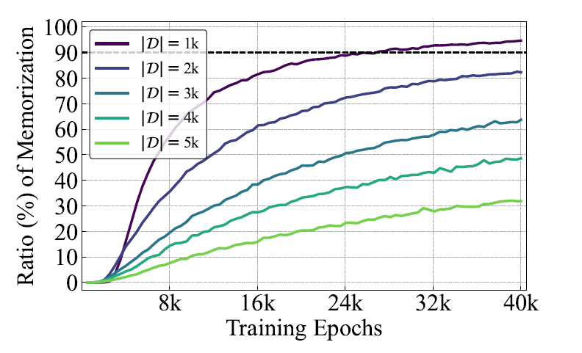
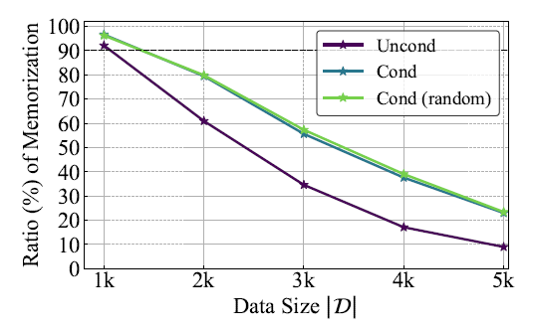
Hypotheses Tested in the Paper
Data Distribution: Dataset size, Data dimensionality, Number of classes, Intra-class diversity
Model Configuration: Model width, Model depth, Time embedding type, Skip connections
Training Procedure: Training duration, Batch size, Weight decay, EMA
Conditioning: Unconditional vs conditional, Random labels, Unique labels
Source: Gu et al. (2025)

Slide 11
Goal of Project
Verify the core findings of Gu et al. (2025) using a simplified DDPM model based on U-Net architecture on CIFAR-10.
Experiment A: Conditioning Type; Compare unconditional, normal, random, and unique labels. Show unique labels trigger the most memorization
Experiment B: Dataset Size; Show memorization increases as training set size decreases
Experiment C: Training Time; Show memorization increases with more training epochs
Experiment D: Varying Random Classes; Show memorization increases as the number of random classes C grows.

Slide 12
Dataset For Experiments

Slide 13
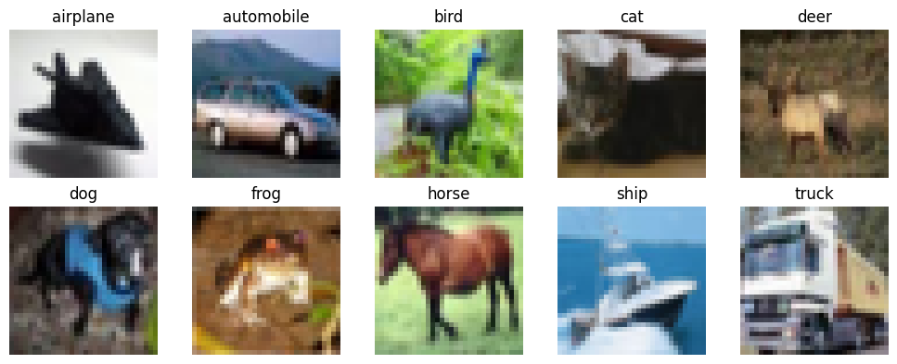
CIFAR-10 Dataset
CIFAR-10 (Krizhevsky, 2009): 50,000 training images, 10 classes, 32x32 RGB
Classes: airplane, automobile, bird, cat, deer, dog, frog, horse, ship, truck; 5,000 images per class

Slide 14
Detailed Problem Setup
Model Architecture:
U-Net diffusion model (DDPM, VP schedule)
Sinusoidal time embedding + MLP projection
Label embedding added to time embedding
Network Design:
Encoder: DownBlocks (3 → 128 → 256)
Bottleneck: ResBlock (256 → 512)
Decoder: UpBlocks with skip connections
Output: Conv → RGB image
~9.5M parameters
GroupNorm + SiLU activations

Slide 15
Detailed Problem Setup (Cont.)
Memorization Evaluation: Compare generated image to nearest training samples. Compute distance ratio: ratio=d1/d2 where d1 is distance to nearest neighbor and d2 is distance to second nearest neighbor
Memorization Criterion:
If ratio < threshold (≈ 1/3) → memorized sample
otherwise → generalized sample
Metrics:
Binary memorization rate: fraction of memorized images
Average ratio: average d1/d2 ratio across all generated images

Slide 16
Detailed Problem Setup (Cont.)
Libraries: PyTorch, torchvision, tqdm, matplotlib, numpy.
Hardware: A100 GPU (SOL, Google Colab, Server)
What we changed vs Paper:
No attention layers (simplification vs EDM paper)
DDPM VP noise schedule vs EDM VE schedule
MSE loss vs EDM weighted loss
~9.5M vs ~56M params
Different hyperparameters to match our compute setup

Slide 17
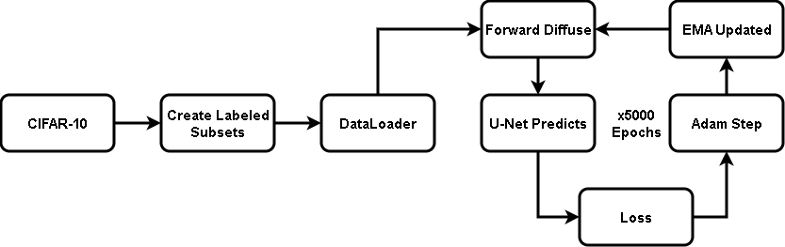
Training and Sampling Pipeline
Training:
Sampling:

Slide 18
Main Results

Slide 19
Experiment Setups
Subsets drawn without replacement and with equal distribution of images from classes
Experiment A: Conditioning
Labels types:
Unconditioned: no labels
Normal: true class 0–9
Random: shuffled 0–9
Unique: index 0 to N-1
Same 1000 images with different labels
Experiment B: Dataset Size
Sizes:
50 images
100 images
250 images
500 images
1000 images
2000 images
5000 images
10000 images
Unique labels
Experiment C: Training Time
Checkpoints:
1000 epochs
2000 epochs
3000 epochs
4000 epochs
5000 epochs
1000 images
Unique labels
Experiment D: Varying Classes
Number of C:
1 C
10 C
50 C
100 C
500 C
1000 C
1000 images
Random labels

Slide 20
Hyperparameters and Ranges
Parameter | Value | Description | Why This Value?
T (timesteps) | 500 | Number of diffusion steps in noise schedule | Reduced from paper's T=1000, giving better training coverage within our epoch budget
Epochs | 5000 | Training epochs per experiment | Reduced from paper’s 40K epochs to maintain a reasonable computation time
Batch size | min(256, |D|) | Images per gradient step | Matches paper baseline
Learning rate | 2e-4 | Adam optimizer lr | Matches paper baseline

Slide 21
Hyperparameters and Ranges (Cont.)
Parameter | Value | Description | Why This Value?
Base channels | 128 | U-Net channel width multiplier | Matches paper baseline
Seed | 42 | Random seed for dataset sampling reproducibility | Chosen at random
Memorization threshold | 1/3 | d1/d2 ratio cutoff for binary metric | Matches paper baseline
num_generated | 2000 | Images generated per evaluation | 2k sufficient to show trend with lower compute; paper uses 10k

Slide 22
Discussion of Results - Experiment A
How does conditioning affect memorization?
Uncond / Normal / Random → ~0% memorization
Unique labels → 99.4% memorization
Forces the model to associate one label with one image
Normal vs Random → essentially identical results Confirms that label meaning does not matter, only label specificity does
Conditioning type is the strongest single driver of memorization. Unique labels alone push a generalizing model to near-perfect memorization on the same dataset
Type | Binary | Avg Ratio
Uncond (no labels) | 0.002 | 0.882
Cond (Normal) | 0.018 | 0.847
Cond (Random) | 0.022 | 0.845
Cond (Unique) | 0.994 | 0.100

Slide 23
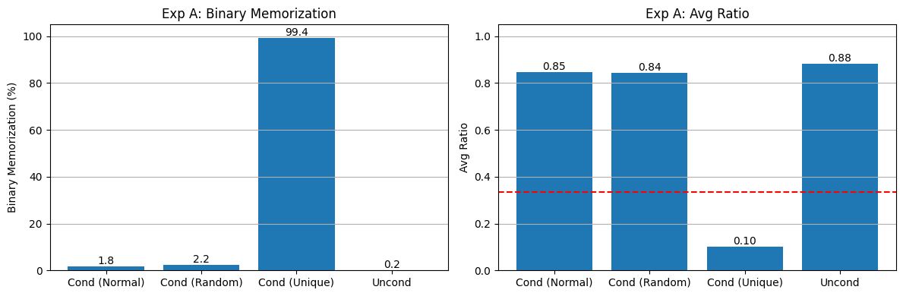
Visualization of Results - Experiment A
Unique labels produce 99.4% memorization while all other conditions stay below 2.2%. Label specificity is the key driver, not label meaning

Slide 24
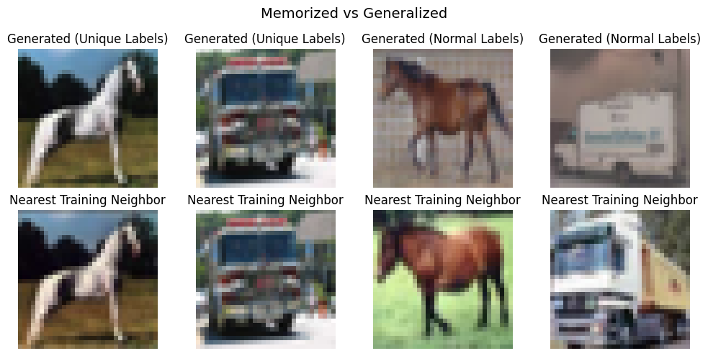
Visualization of Results - Generated Samples
Near pixel-level copies confirm the model is retrieving specific training images rather than generating novel content

Slide 25
Discussion of Results - Experiment B
How does dataset size affect memorization?
Small datasets (≤500) → 100% memorization
The model has enough capacity to memorize every image
Larger datasets → memorization gradually decreases Shows memorization weakens gradually rather than dropping sharply
Binary memorization saturates at 100% for small datasets. The avg d1/d2 ratio is the meaningful signal, rising steadily from 0.067 to 0.513 as dataset size grows
Dataset Size | Binary | Avg Ratio
50 | 1.000 | 0.067
100 | 1.000 | 0.072
250 | 1.000 | 0.084
500 | 1.000 | 0.093
1000 | 0.998 | 0.102
2000 | 0.990 | 0.131
5000 | 0.902 | 0.214
10000 | 0.330 | 0.513

Slide 26
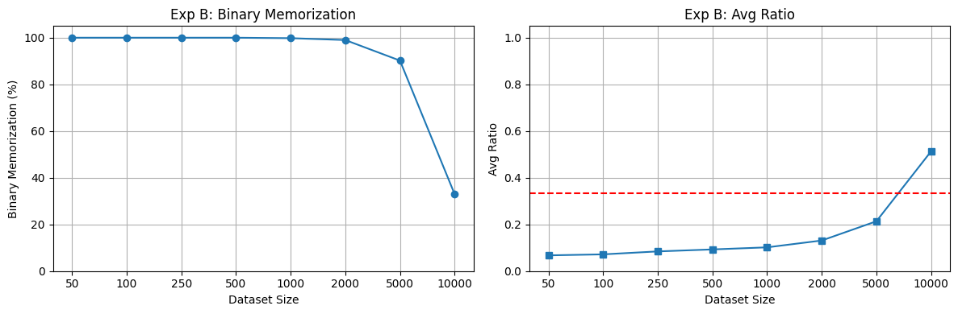
Visualization of Results - Experiment B
Binary memorization stays at 100% until dataset size exceeds 2000. Smaller datasets give the model fewer images to distinguish between, making exact recall easier than generalization.

Slide 27
Discussion of Results - Experiment C
How does training duration affect memorization?
Early (1000 epochs) → mostly generalization
1000 → 2000 → sharp jump in memorization
Memorization emerges rapidly once the model has seen each image enough times to associate it with its unique label
After 3000 → saturation ~100%
Memorization is not gradual. It emerges in a sharp phase transition between epochs 1000 and 2000, then saturates. The model flips from generalization to memorization as training crosses a threshold
Epoch | Binary | Avg Ratio
1000 | 0.180 | 0.574
2000 | 0.812 | 0.250
3000 | 0.976 | 0.156
4000 | 0.996 | 0.120
5000 | 0.998 | 0.104

Slide 28
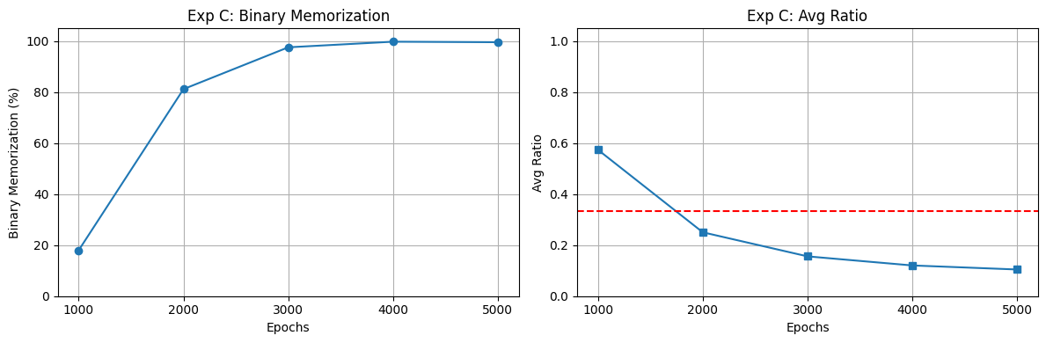
Visualization of Results - Experiment C
A sharp phase transition between epochs 1000 and 2000 and it flips from generalization to memorization.

Slide 29
Discussion of Results - Experiment D
How does the number of random classes affect memorization?
Few classes → low memorization
Many images share the same label so the model can generalize
More classes → memorization increases
Each label now covers fewer images, reducing the model's ability to generalize within a group
1000 classes → ~100% memorization
equivalent to unique labels
Memorization scales with label specificity. The fewer images per class, the less the model can generalize within a group. At C=|D|=1000 every image has its own label and memorization reaches 99.8%
Classes | Binary | Avg Ratio
1 | 0.006 | 0.871
10 | 0.018 | 0.847
50 | 0.100 | 0.765
100 | 0.206 | 0.668
500 | 0.576 | 0.420
1000 | 0.998 | 0.098

Slide 30
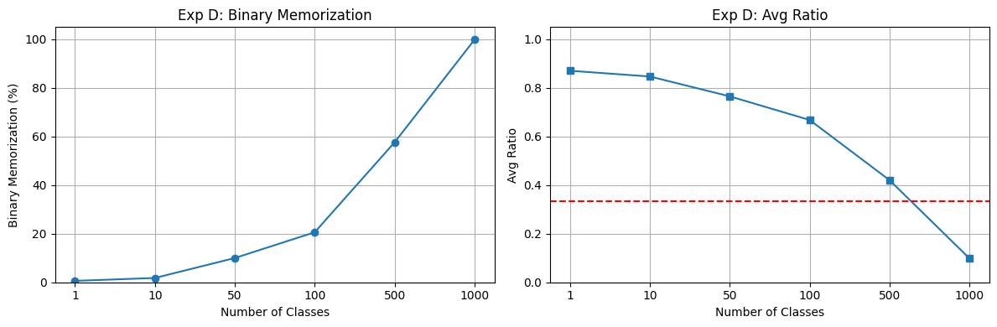
Visualization of Results - Experiment D
As the number of random classes increases, each label covers fewer images, forcing the model toward memorizing individual samples

Slide 31
Discussion of Results (Contd.)
Wall Clock Time:
All experiments took ~80 hrs. Most experiments were run in parallel.
What Worked:
All four experiments produced results in the correct direction matching the paper's findings
Simpler model was able to reproduce the key memorization behaviors. Visual results confirm memorization.
What Didn't Work:
Binary metric alone was not enough. avg d1/d2 ratio was needed to recover the trend, which is not a metric the paper reports directly
The paper's dataset size and training time experiments use normal label conditioning as the baseline, not unique labels. We switched to unique labels to produce visible memorization within our 5,000 epoch budget

Slide 32
Pros and Cons of Approach
Pro:
Accessible replication; core memorization phenomena reproduced on a single A100 in a realistic time frame, making the paper's findings verifiable without large-scale compute infrastructure
Also shows us that memorization behavior does not depend on model complexity
Cons:
Simplified model limits scope; our 9.5M parameter DDPM cannot fully reproduce the memorization results across all configurations tested in the paper with a 56M parameter EDM

Slide 33
Course Concepts
Forward (noise) and reverse (denoising) process
Sampling
Generalization and overfitting

Slide 34
References
Jennewein, Douglas M. et al. "The Sol Supercomputer at Arizona State University." In Practice and Experience in Advanced Research Computing (pp. 296–301). Association for Computing Machinery, 2023.
Gu, X., Du, C., Pang, T., Li, C., Lin, M., & Wang, Y. (2025). On Memorization in Diffusion Models. Transactions on Machine Learning Research
Carlini, N., Hayes, J., Nasr, M., Jagielski, M., Sehwag, V., Tramèr, F., Balle, B., Ippolito, D., & Wallace, E. (2023). Extracting training data from diffusion models. arXiv

Slide 35
Thank You
Questions?

